Slide 1
Wireless Networks
Lecture 26
Wireless LAN / IEEE 802.11

Slide 2
Outlines
Overview of IEEE 802.11
IEEE 802.11 Protocols
Architecture
Services
MAC Protocols
DCF
PCF

Slide 3
Standardization of Wireless Networks
Wireless networks are standardized by IEEE.
Under 802 LAN MAN standards committee.
Application
Presentation
ISO
OSI
7-layer
model
Session
IEEE 802
standards
Transport
Network
Logical Link Control
Data Link
Medium Access (MAC)
Physical
Physical (PHY)
Notes:
Same organization that came up with IEEE 802.3 Ethernet,
which is responsible for success of Internet

Slide 4
Overview, IEEE 802.11 Committee
Committee formed in 1990
Wide attendance
Multiple Physical Layers
Frequency Hopping Spread Spectrum
Direct Sequence Spread Spectrum
Infrared
2.4GHz Industrial, Scientific & Medical shared unlicensed band
2.4 to 2.4835GHz with FCC transmitted power limits
2Mb/s & 1Mb/s data transfer
Draft 5.0 Letter Ballot passed and forwarded to Sponsor Ballot
Published Standard adopted in 1997

Slide 5
IEEE 802.11 Overview
Goals
To deliver services in wired networks
To achieve high throughput
To achieve highly reliable data delivery
To achieve continuous network connection.

Slide 6
WLAN Requirements
Throughput
Number of Nodes/Scalability
Connection to Backbone LAN
Service Area: 100 to 300 m
Power Consumption
Transmission Robustness and Security
Collocated network Operation
License-free operation
Handoff/Roaming
Dynamic Configuration

Slide 7
IEEE 802.11 Protocols
IEEE 802.11a: PHY Standard : 8 channels : 54 Mbps : 5 GHz band: OFDM.
IEEE 802.11b: PHY Standard : 3 channels : 11 Mbps : 2.4 GHz band: FHSS, DSSS.
IEEE 802.11d: MAC Standard : operate in variable power levels :
IEEE 802.11e: MAC Standard : QoS support : EDCF.
IEEE 802.11f: Inter-Access Point Protocol : 2nd half 2002
IEEE 802.11h: Supplementary MAC Standard: Enhanced version of 802.11a to support European Regulatory provides TPC and DFS.
IEEE 802.11i: Supplementary MAC Standard: Alternative WEP
IEEE 802.11n: 100 + Mbps : Enhancement to 802.11g using MIMO
IEEE 802.11s: mesh networking extension

Slide 8
IEEE 802.11 Architecture
WLAN is based on cellular architecture
Each cell/Basic Service Set (BSS) is controlled by a base station/Access Point (AP).
Access Points are connected with backbone called Distribution System (DS).
The whole interconnected WLAN through DS form Extended Service Set (ESS) as a single layer in OSI model.
Mobile Station (MS) in BSS with no connection to other BSSs form Independent BSS (IBSS).

Slide 9
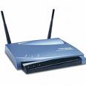
Wireless LAN / IEEE 802.11
Fixed Host
IBSS
Distribution System
Access Point
Mobile Host
Basic Service Set
Expanded Service Set

Slide 10
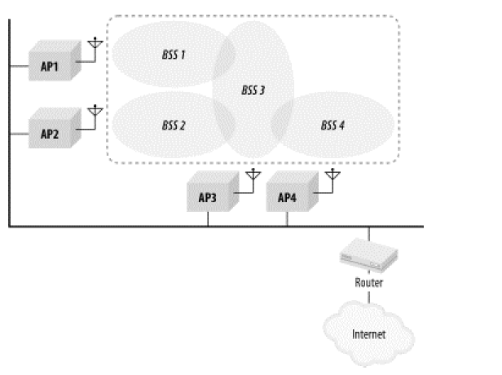
ESS

Slide 11
Access Point functions as a bridge and a relay point.
In BSS, MS communicate through Access Point
IBSS is typically an ad hoc network, where station communicate directly.
To integrate 802.11 with 802.2 (Wired LAN), a portal is used.
Portal is a device such as bridge or router attached to DS.

Slide 12
802.11 Services
IEEE 802.11 defines nice services.
Three services for WLAN access and confidentiality.
Six services used to support delivery of MAC Service Data Unit (MSDU) between stations.
Notes:
802.11 defines 9 services that need to be provided by the wireless LAN to provide functionality equivalent to that which is inherent to wired LAN.
Service provider can be either station or DS.
Distribution services are provided between BSSs. They are either implemented in AP or some special device attached to DS.

Slide 13
Messages Distribution in ESS
Two services involved in distribution of messages within DS.
Distribution
Primary service used to exchange MAC frames between stations of two BSSs.
Source sends to AP of one BSS, which sends to DS. DS then sends to AP of the destination.
Message transport in DS is beyond the scope of IEEE 802.11 standard.

Slide 14
Integration
Enables transfer of a data between a station on an IEEE 802.11 LAN and a station on an integrated IEEE 802.x LAN (Wired LAN).
It takes care of any address translation and media conversion logic

Slide 15
Association-Related Services
Three services are implemented
Association:
Establishes an initial association between a station and an AP
AP can communicate its identity to other APs within ESS to facilitate routing and delivery of addressed frames.
Re-association
Enables an established association to be transferred from one AP to another
Disassociation
A notification from either a MS or AP that an existing association has terminated.

Slide 16
Access and Privacy Services
Authentication
Establishes the identity of stations.
However, IEEE 802.11 requires mutually acceptable, successful authentication before association.
De-authentication
Invoked to terminate existing authentication
Privacy
Standard provides optional use of encryption to assure privacy

Slide 18
IEEE 802.11 Medium Access Control (MAC)
MAC Layer provides three functions
Reliable data delivery
Medium access control
security

Slide 19
IEEE 802.11 Protocol Architecture
Logical Link Control (LLC)
Contention-free
Service
Contention
Service
Point Coordination Function (PCF)
Distributed Coordination Function (DCF)
802.11
2.4 GHz
FHSS
802.11
2.4 GHz
DSSS
802.11
Ird
802.11a
5 GHz
OFDM
802.11b
2.4 GHz
DSSS
802.11g
2.4 GHz
OFDM

Slide 20
Reliable Data Delivery
Reliability at TCP level?
Significant delay due to wait timers
Reliability at MAC
Quick fix
Hop by hop ACK at MAC as atomic operation.

Slide 21
MAC Protocol
Two types of algorithms:
Distributed access protocol
Distribute the decision to transmit
Centralized control
Better in ESS, when AP connected to DS

Slide 22
Distributed Coordination Function (DCF)
DCF sub layer uses CSMA algorithm
Collision detection as in Ethernet is not possible in wireless comm.
It implements collision avoidance (CA) algorithm.
It uses a set of delays of different periods called inter-frame space (IFS)
Notes:
CD is not possible in WLAN because
It requires Full-Duplex radio, capable of transmitting and receiving at same time.
Sometimes CD is not possible due to hidden node problem.
Therefore, It uses CA algorithm

Slide 23
CSMA/CA
A Station willing to transmit senses the medium.
If the medium is busy, defers
If idle, wait for Distributed Inter-Frame Space (DIFS) or Exponential back off.

Slide 24
CSMA/CA Algorithm
Frame to
transmit
Medium
Idle?
No
Wait until
Trans ends
Yes
Wait IFS
Wait IFS
Still
Idle?
No
Still
Idle?
No
Yes
If medium becomes busy during the backoff
time, the backoff timer is halted and
resumes when the medium becomes idle.
Yes
Exp b/o while
Medium idle
Transmit frame
Transmit frame

Slide 25
Example
A is transmitting a frame when B, C and D sense the channel.
B, C, and D run their random number generator to get a back off time
station C draws the smallest number followed by D and B.
After completion of A:
B, C, D wait for the IFS period and start their counters.
C finishes first and starts transmission, after checking again whether the medium is idle.
B and D freeze their counters.
After completion of C: B and D wait for the IFS period and (re-) start their counters

